Slide 1
Job Resumes
Presenter : Deepti Agarwal
Assistant Professor
HSS,UIET, CSJMU
Kanpur

Slide 2
Important Features of a Resume
It creates a crucial first impression.
It should highlight the key skills of an applicant.
It should be well organized, properly written, and presented with an appropriate layout.
Its purpose is to persuade that you have the abilities, skills, and personal qualities that the employer is looking for.
It should have a catchy appearance
It should be free of spelling errors and grammatical errors.
A good resume is accompanied by a well-drafted cover letter.

Slide 3
Elements in a Job Resume
Contact Information
Career Objective
Education
Employment/ Work Experience
Professional Skills
Activities and interests
Awards/ Honors/ Achievements
References

Slide 4
Contact Information
Name
Address (Current Address of correspondence)
Telephone no.
Email Id ( Professional)- (Avoid informal id add. for professional correspondence- Cool girl @gmail.com; hot boy @ gmail.com)

Slide 5
Career Objective
Career objective conveys that applicant’s skills befit the job profile which would benefit the prospective organization’s growth.
Flawed: Seeking employment in a business environment offering an opportunity for my professional growth and aspirations. (informs about your objective)
Good: Achieving excellence as a computer programmer. (informs about your goal)
Better: To market financial planning programs and provide financial counseling to assure positive client relations.

Slide 6
To utilize my technical skills and analytical skills in the growth and development of organization.
To utilize my technical skills in company’s progress, and to hone my skills by handling challenging situations.
To make the best use of knowledge by implementing and by imparting progressive solutions for the growth and development of organization.

Slide 7
Academic Qualification/ Education
Applicant’s academic record from present to the past (reverse chronological order).
Information can be provided in tabular form or in sections by including the following information:
a. Name of College/ School/ Institute
b. Name of Course
c. Name of the Board
d. Percentage/ C. G. P.
e. Year of passing

Slide 8
Tabular Form
Degree | University/College | Year | CGPA/ Division
Bachelors in Technology in Chemical / Electrical branch | University Institute of Engineering and Technology (U. I. E. T.), Chhatrapati Shahu Ji Maharaj University, Kanpur (C. S. J. M. U.) | 2018-2021 | 6.7 (till the sixth semester)

Slide 9
Graduation
Institution: University Institute of Engineering and Technology
Degree: B. Tech in Chemical branch
Year of Graduation: 2021
CGPA: 8.3 (Till sixth semester)
XII
School:……….
Board:……………
Year of passing………..
Percentage……………..
X
School:………….
Board:……………….
Year of passing:………………
Percentage……………

Slide 10
Employment/ Work Experience
S.No. | Designation | Company | Pay Scale

Slide 11
Professional Skills
Software skills + Technical skills
Software Skills:
Languages Known: C, Java, Perl
Scripting: Shell programming, HTML, XML
Operating Systems: Unix, Linux, Windows 95/98
Data Bases: SQL (oracle)
How to write:
Managed a retail design studio producing over . . .
I Hired, Trained, and supervised
I Provided Training

Slide 12
Professional Affiliations
Mention membership in various professional organizations/societies, etc.

Slide 13
Activities/ Interests
Co-curricular ( Be brief)
Any other special interests
For example:
Conducted programming competitions in College Fest, “ Techno-Spandan” 2019
Secured Runners-up position in Table Tennis Zonal Championship, 2021

Slide 14
Awards/ Honor/ Achievements
Academic/ Non-academic
Professional
I have Presented a research paper in International Conference organized by I. I. T Kanpur on topic, “…………………..”in 2018-2019.
I was a Member of a awareness campaign “ To say no to drugs” organized by Student Activity Club, UIET in 2019.
Won first place in Oratorical Contest held during National Science Day Competition 2019.

Slide 15
Personal Information
Name:
Father’s Name:
Date of Birth:
Gender:
Marital Status:
Nationality:
Languages:

Slide 16
References
2 from university/earlier organization
1 from reputed person
Referred by:
ABC
XYZ

Slide 17
Common Errors while drafting resumes
Sameer kushwaha
Address: ??????????
Phone : 9807501405
E-mail: sameerkushwaha07@gmail.com
Career Objectives
An enthusiastic fresher with highly motivated and leadership skills pursuing bachelors of engineering degree in Mechanical Engineering.
To utilize my technical knowledge in product designing by providing better solutions catering company’s goal.

Slide 18
Education
Pursing B.TECH./ B. Tech. from U. I. E. T., C.S.J.M. (why abbreviation in the introduction?)University Kanpur (year is missing)& secured CPI 7.66 out of 10 till 5th semester.
Passed 12th from U.P. Board Prayagraj in 2016( what was the %)
Passed 10th from U.P.Board Prayagraj in 2014. ( what was the %)

Slide 19
Training( Summer Training/ Internship)
1.OEF??? kanpur for 30 days
Software Skills
Languages: Java . . .
MS Office(MS Word, MS Excel, PowerPoint)
Extra Curricular Activities
Reading books.
Try to do something new.??

Slide 20
Personal Details
Father’s Name:-Mahendra Singh
Date Of Birth:-2nd july2000
Address:-151,Saraswati Nagar Naubasta Kanpur Nagar
Languages Known:-Hindi, English
Date: 23rd April, 2020
Place: Kanpur Signature:
SAMEER KUSHWAHA

Slide 21
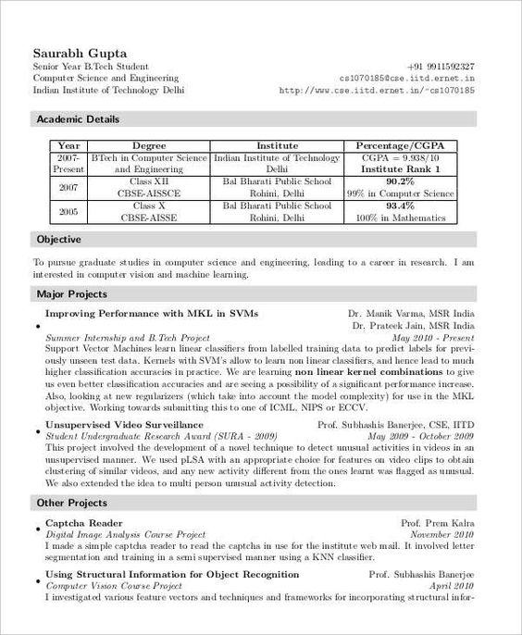
Let us review the given Resume

